Slide 1
ADB support to IWRM
Core concepts and Initiatives in India
Odisha and Karnataka
National Workshop on IWRM
Arnaud Cauchois
Sr. Water Resource Specialist
02-03 February 2015
ADB

Slide 2
Outline of the presentation
Core concept
Orissa Baitarani River Basin
Some lessons learned
Karnataka I&SWRMP

Slide 3
What is IWRM?
IWRM is a process
that brings stakeholders together
to increase water security in river basins
through win-win solutions
that are locally appropriate
and generate a triple bottom line of economic, social and environmental outcomes
IWRM is not a plan

Slide 4
IWRM Process in Basins
Progress of IWRM
Finding Keys for success
Road map for investment program
in adaptive management
Changing conditions
Project
5. Recognizing &
identifying
2. Conceptualizing
3. Coordinating &
planning
1. Recognizing &
identifying
4. Implementing,
monitoring & evaluating
Notes:
Ac: Many of you are now familiar with the spiral model which were developed by UNESCO and NARBO with ADB funding – These illustrate what we mean by IWRM process. Contrary to what may have been applied in the earlier days of IWRM, It is to be seen a succession of stages rather than a plan– Each stage is here represented by one spiral . One spiral can correspond to the implementation of a project or a plan and is characterize by a specific cycle , several spirals may correspond more to the basin investment road map…At each spiral we progress towards achieving IWRM but while we do this we keep adapting to the context and the changing conditions. Through adaptative management we progressively find the key for success..

Slide 5
National Workshop on IWRM - Delhi
-Odisha integrated irrigated agriculture and water management investment program – Baitarani River Basin

Slide 6
OIIA&WMIP Facts sheet
Multi tranche investment program approved by ADB board in September 2008
$ 267.7 million for 10 years program
Supports Sustainable and increased irrigated productivity.
Supports institutional strengthening including IWRM for the entire state with piloting in Baitarani river basin
Implementation slow – progress below expectations.

Slide 7
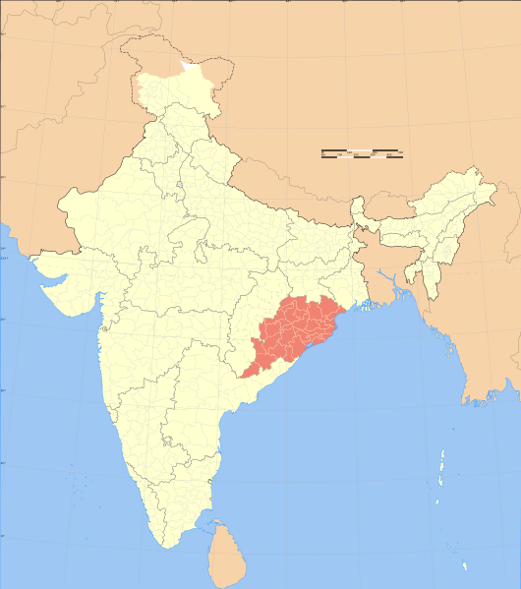
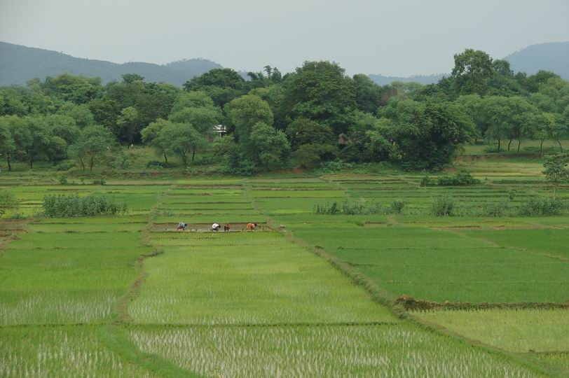
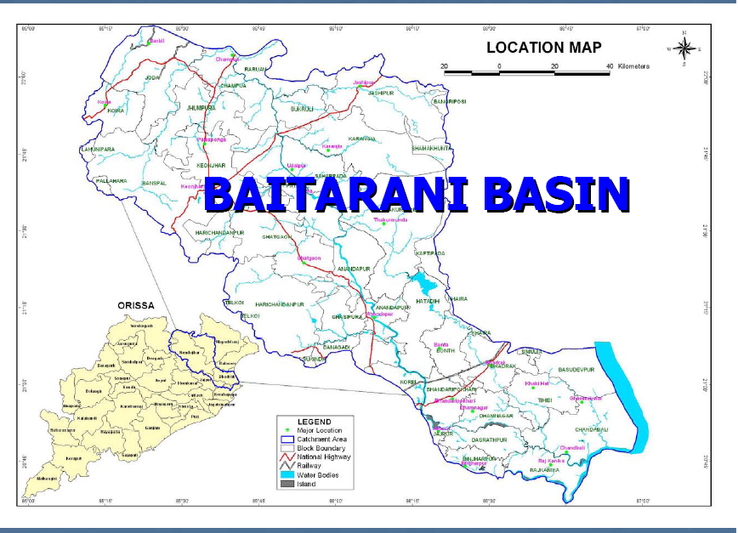
Odisha and the Baitarani basin
INDIA
ODISHA
OdISHA

Slide 8
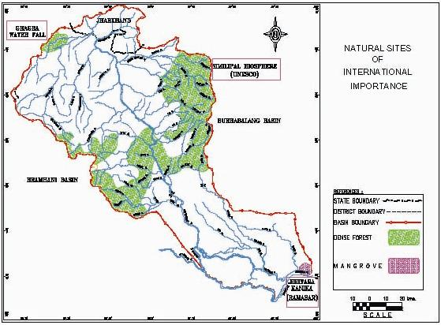



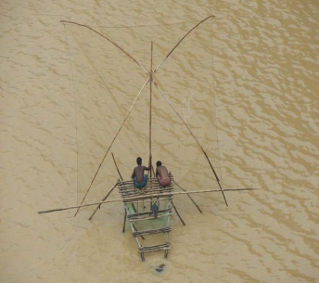
Basin Profile and Issues
●Population: 4.4 million
● Irrigation: present 240,000 ha (both seasons)
● Industries: Mining and Metallurgical
● Urban centers : 12 – 10-15% pop/19654 ltrs/year waste
● Fisheries : 23518 MT/year
● Protected areas : Wild Life Parks (UNESCO) and Wetlands (Ramsar).
mining
mining
Industries
T
Similipal biosphere
(Unesco)
Industries
T
T
Similipal wild life
reserve
T
T
T
Bithara Tanika
Wild Life Sanctuary
(RAMSAR)

Slide 9
IWRM Progress in Baitarani river basin
1st Stakeholder meeting for Integrated Roadmap
(2010)
Conceptualizing RBO Structure
(2010)
Conceptualizing OIIAWMIP Roadmap
(2008-)
Consultation and agreement on the draft IWRM road map
(2012
[2008-2017]
OIIAW MIP Road Map
2. Conceptualizing
3. Coordinating &
planning
[2003-2007]
Integrated Master Plan
4. Implementing,
monitoring &
evaluating
Formation of
the RBO (decree)
2012
State Water Policy revision
(2007)
Implementation of OIIAWMIP
(2009-2017)
[1993-2002]
State Water Policy
Implementation of the Integrated Roadmap
(2010-18)
1. Recognizing &
identifying
2014
The second IWRM spiral was aborted due to the withdrawal of the World Bank support
Completed or ongoing Activities
Missing/future
Activities
* The 1st Tranche Irrigation Infrastructure Investment Program

Slide 10
Odisha institutional road map towards IWRM 2008-2018
Envisages step by step progress in introducing IWRM following 2007 state Water Policy:
Capacity development including :
(i) strengthen grass root stakeholders consultation
(ii) strengthening Orissa Water Planning Organization (OWPO),
(iii) transform OWPO into a Water Mission training , mentoring, M&E..
Implementing actions including:
(i) informed dialogues and awareness raising,
(ii) Water planning
(iii) Water allocation and pricing including
(iv) Water Law Regulatory reforms

Slide 11
IWRM Road map –results so far
Below expectations:
Capacity development including :
(i) strengthen grass root stakeholders : nothing except reports online
(ii) strengthening OWPO: limited to a GIS unit and training of 3 staffs
(iii) transform OWPO into a Water Mission : not initiated – too ambitious
Implementing actions including:
(i) informed dialogues and awareness raising: No action
(ii) Water planning : Baitarani RBO established through decree but has not yet met, little action beyond that no basin plans, no progress on IS, E-flow may be too ambitious.
(iii) Water allocation and pricing : (a) Odisha Water Regulatory Authority proposal sent to government but reservations, no other progress
(iv) Water Law Regulatory reforms including no actions.
Notes:
AC: However after 6 years the progress in the implementation of the road map are below expectations –
(ii) Water planning : (a) the development of state and water plan, (b) Establish Baitarani RBO, (c) Develop Baitarani Basin plan, (d) establish Hydrological information systems , (e) Assess environmental flow - too ambitious and (f) establish inter state agreements ;
(iii) Water allocation and pricing including (a) establish Orissa Water Regulatory Authority, (b) assigning access rights, O&M cost recovery and volumetric water prices;
(iv) Water Law Regulatory reforms including (a) establish Orissa Water Regulatory Authority, (b) prepare state water act.

Slide 12
Some lessons learned
Build capacity and leadership – one champion not enough – only engineers not conducive – state must invest in building capacity for IWRM
Secure public participation and ownership –communication plan
Put more effort on the “how” than the “what” to do – practical work-plan versus prior set of actions
Start with most pressing issues, and the lower hanging fruits, progress step by step - in the basin and most affected basins (need a crisis)
IWRM road map as guiding framework – not prescriptive

Slide 13
Thanks for your attention
ADB

